Slide 1
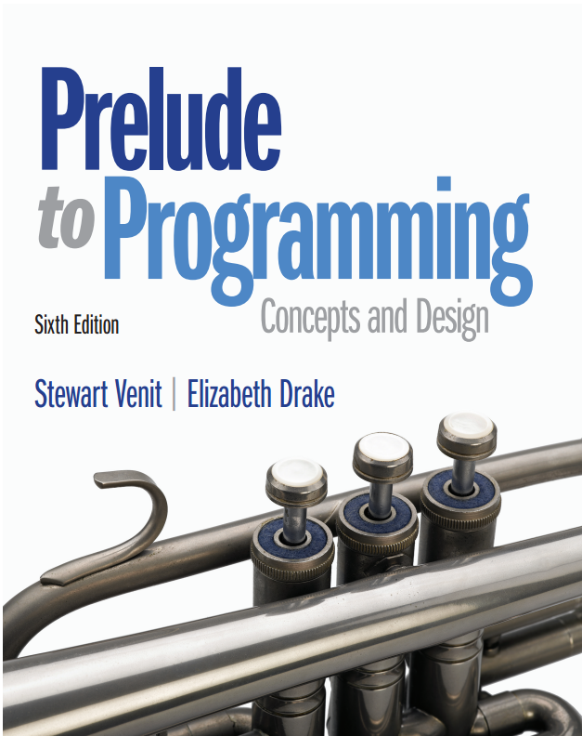
Prelude to Programming
Sixth Edition
Chapter 7
Arrays: Lists and Tables
Copyright © 2015, 2011, 2009 Pearson Education, Inc. All Rights Reserved
Notes:
If this PowerPoint presentation contains mathematical equations, you may need to check that your computer has the following installed:
1) MathType Plugin
2) Math Player (free versions available)
3) NVDA Reader (free versions available)

Slide 2
7.1 One-Dimensional Arrays
A one-dimensional array is a list of related data of the same data type, referenced by the same name.
An array is composed of elements, each of which is referenced by the array name and the element’s position in the array.

Slide 3
Array Basics (1 of 2)
Array elements are stored in consecutive memory locations.
The position of an element in an array is called a subscript or an index.
Given an array named Scores[], in the element Scores[3], Scores is the array name and 3 is the subscript.
Each individual element of an array is referred to by writing the array name followed by its index number surrounded by brackets.
In most languages the first element of an array has index number 0

Slide 4
Array Basics (2 of 2)
The first element of the array Scores would be referred to as Scores[0]
The second element is Scores[1]
The third is Scores[2]
Read these as “Scores sub 0”, “Scores sub 1”, and “Scores sub 2”

Slide 5
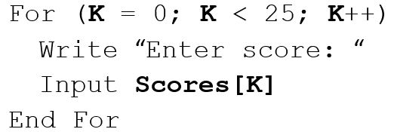
Entering Elements into an Array
If we wanted to input the final exam scores of a class of 25 students using an array named Scores which has 25 elements, we could use a loop as follows:
Note that, since the count (K) begins at 0, the test condition goes up to 24 (the loop ends when K = 25) to enter 25 elements.

Slide 6
Declaring Arrays
When an array is declared, the computer sets aside memory to store the values of the elements of the array.
Declaring an array means telling the computer what is the data type of the array and how many elements will be stored in it.
Pseudocode to declare arrays:
Declare Age[6] of Integers
declares an array with 6 elements, all of which must be integers
Note: the first element of an array has subscript 0
Address | Age[0] | Age[1] | Age[2] | Age[3] | Age[4] | Age[5]
Contents | 5 | 10 | 15 | 20 | 25 | 30

Slide 7
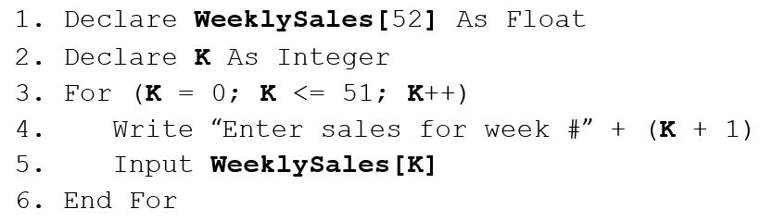
Filling (loading) an Array
Here is how to load an array with 52 values. The values represent a salesperson’s sales for each week of the year.
Note that the sales for Week 1 correspond to the element WeeklySales[0] and the sales for Week 52 correspond to the element WeeklySales[51].

Slide 8
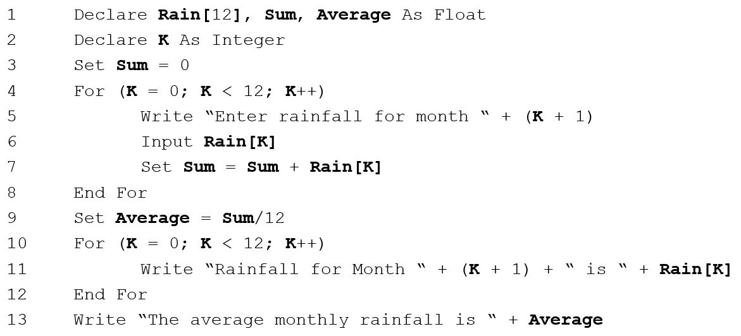
Example: Rainfall Amounts

Slide 9

7.2 Parallel Arrays
Parallel arrays are arrays of the same size in which elements with the same subscript are related.
They can be used when array variables are related to each other by position or subscript.
The data in each array must be loaded in the correct order.
Example: Given: arrays NumberGrade and LetterGrade, each element of NumberGrade is related to an element in LetterGrade by the position in the array.

Slide 10
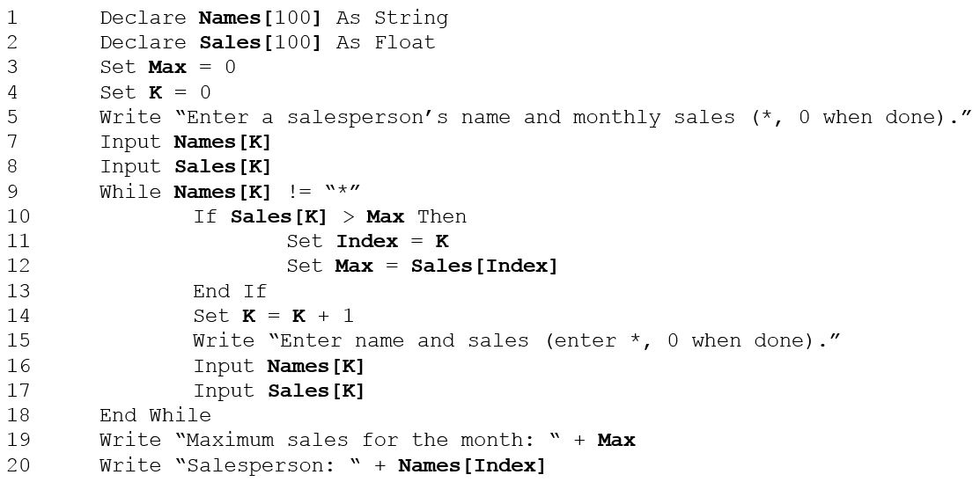
Example: Use Parallel Arrays to Find the Best Salesman

Slide 11
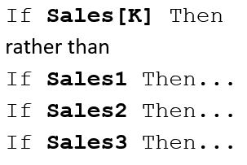
Why Use Arrays?
Arrays reduce the number of variable names in the program.
Sales[K] versus Sales1, Sales2,... SalesN
Arrays improve efficiency by allowing data to be read into the program once but processed as many times as necessary.
Arrays increase the flexibility of the program.
Arrays reduce the number of If-Then statements needed in selection processing.

Slide 12
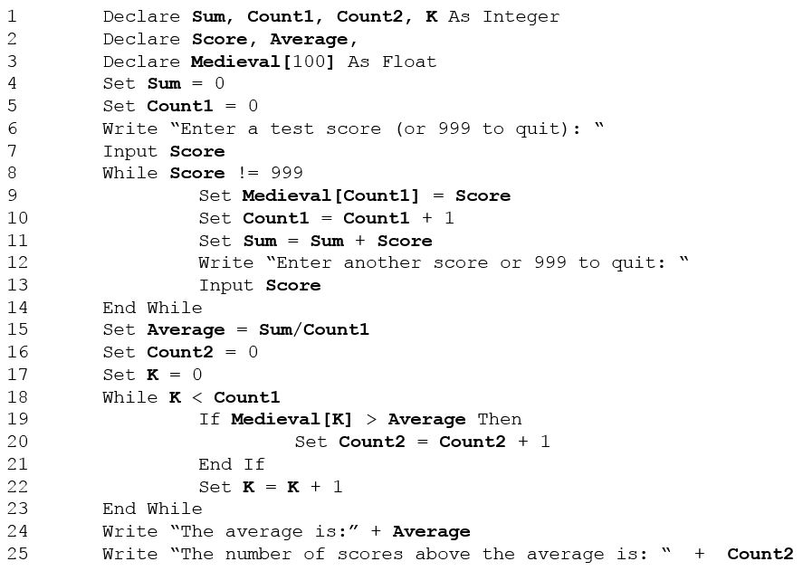
Arrays Save Time and Effort

Slide 13
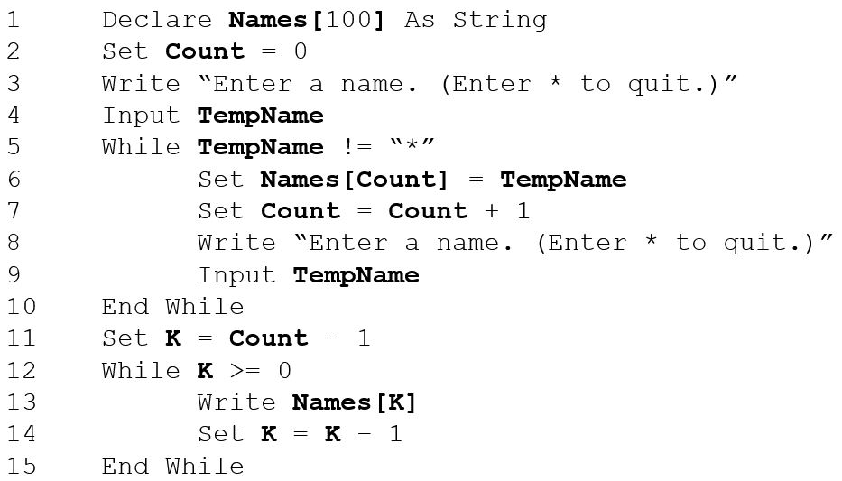
Arrays Make Programming Easy and Concise

Slide 14
A Word About Databases
Databases consist of many tables that are linked in many ways.
A table can contain lists of related data.
A table is a group of parallel lists.
The information in the tables can be retrieved and processed for a large variety of purposes.
Often information from a table is stored as an array in a computer program for easier manipulation.

Slide 15
How Databases May Be Used (1 of 2)
Imagine a database used by a company that provides and sells online computer games.
The company might have tables that store information about people who play each game.
To do market research:
Each table relating to one game might include players’ information like name, username, age, dates played, scores, and so on.
Research might only want to identify which age groups gravitate to which types of games.
By performing what is called a query, the owner can get this information quickly from the database.

Slide 16
How Databases May Be Used (2 of 2)
Using the same tables in the database the company’s market research team can compile many types of information.
Queries can discover which games are played most often on weekends, during daytime hours, how many players of what ages, gender, or even location are most likely to play which types of games, and much more.

Slide 17
How Do Arrays Fit in?
The data retrieved from databases is processed and displayed through computer programs.
Often the required information from the tables is temporarily stored in parallel arrays.
It is manipulated, processed, and the results are output not directly from the database but from the arrays in the programs that are written by programmers.
While it is important to understand how to get and use information to load arrays directly from a user, understanding how to use arrays has a much more far-reaching purpose.

Slide 18
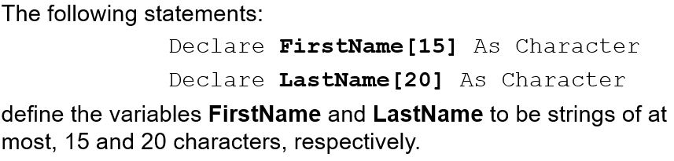
7.3 Strings As Arrays of Characters
Some programming languages do not contain a String data type.
Strings are implemented as arrays whose elements are characters.
In programming languages that contain the String data type, strings can be formed as arrays of characters.
To define a string as an array of characters, indicate the data type in the Declare statement.

Slide 19
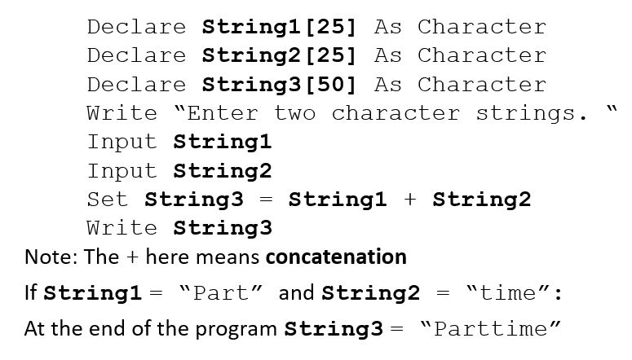
Stringing Arrays Together

Slide 20
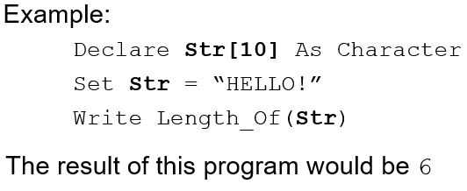
String Length vs Array Size
The length of a string is the number of characters it contains.
In previous slide, the array String3 is declared as an array of 50 elements
But when “Parttime” is assigned to String3, only the first eight array elements are used
Thus, the length of the string “Parttime” is 8

Slide 21
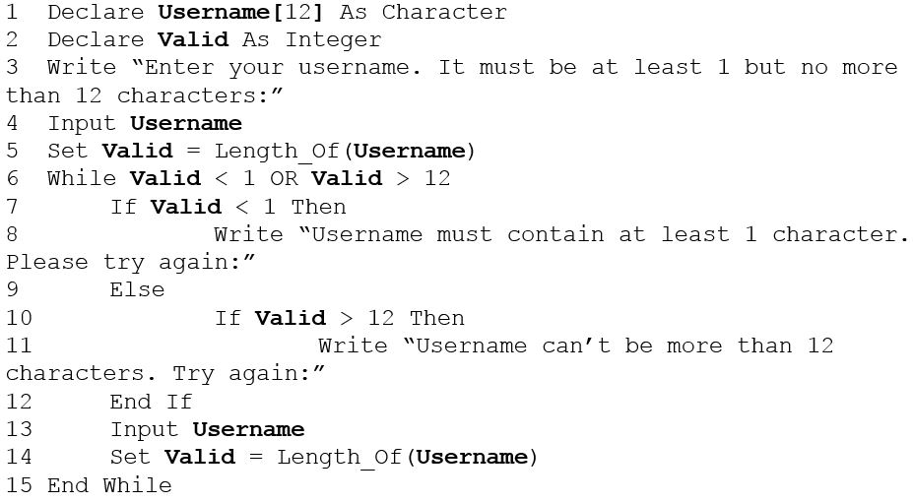
Using the Length_Of() Function to Validate Input

Slide 22
Example: Using Character Arrays (1 of 2)
The next example (pseudocode on next slide) allows the user to input a person’s full name (first name, then a space, then last name). It stores the initials of that person as characters, and displays the name in the following form: LastName, FirstName
This pseudocode uses three character arrays (strings): the input name as FullName, and the first and last names as FirstName and LastName.
It uses two character variables to store the initials, First Initial and Last Initial.
The trick to identifying which part of the input string is the first name and which part is the last name is to locate the blank space between them.
Assume that the following arrays and variables have been declared:
Character variables: First Initial, Last Initial
Integer variables: J, K, Count

Slide 23
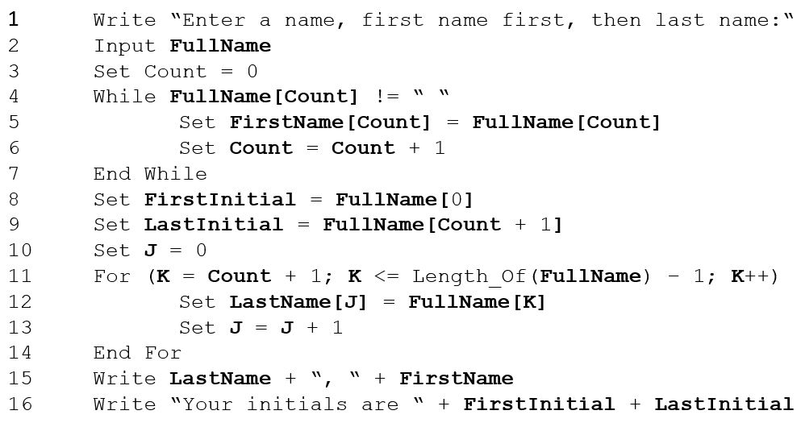
Example: Using Character Arrays (2 of 2)

Slide 24
7.4 Two-Dimensional Arrays
In a two-dimensional array, the value of an element depends on two factors instead of just one.
Sometimes it’s convenient to use arrays whose elements are determined by two factors.
Example: the records of the monthly sales for salespeople for a year:
Each salesperson has 12 numbers (one for each month’s sales) associated with him or her.
The value we look for would depend on which salesperson and which month is of interest.
In these cases, we use two-dimensional arrays.
Here is how to declare a two-dimensional array:

Slide 25
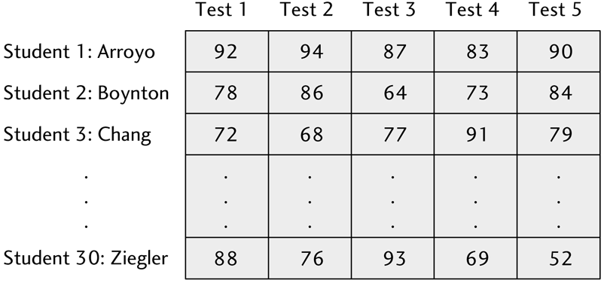
Example: A Two-Dimensional Array
A two-dimensional array is like a matrix or an electronic spreadsheet
Two factors can be, for example, Row and Column or Test Number and Student
In the example below, Boynton’s (Student #2) scores can be referenced as:
Score[1,0], Score[1,1], Score[1,2], Score[1,3], Score[1,4]
Notice the ‘1’ subscript for Boynton remains constant, while the subscript for Test changes

Slide 26
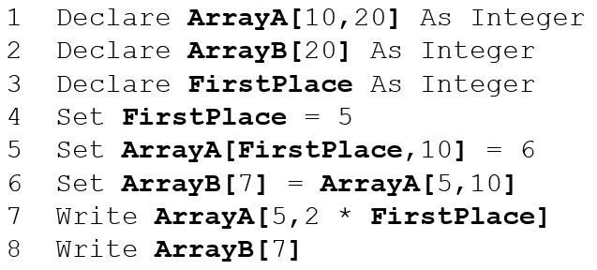
Basics of Two-Dimensional Arrays
The assignment statement on line 5 sets Array A[5,10] equal to 6. In other words, the value of the 6th row, 11th column of Array A is equal to 6.
The assignment statement on line 6 sets Array B[7] equal to the value of Array A[5,10], which is a 6. So now the value of the 8th element in Array B = 6.
The Write statements on lines 7 and 8 display the value of the element in the 6th row, 11th column of Array A and the value of the 8th element of Array B so the number 6 will be displayed twice.

Slide 27
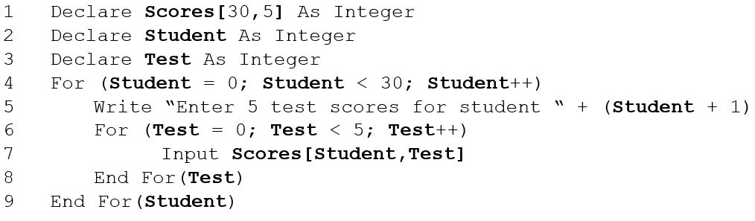
Use Nested Loops to Load a Two-Dimensional Array

Slide 28
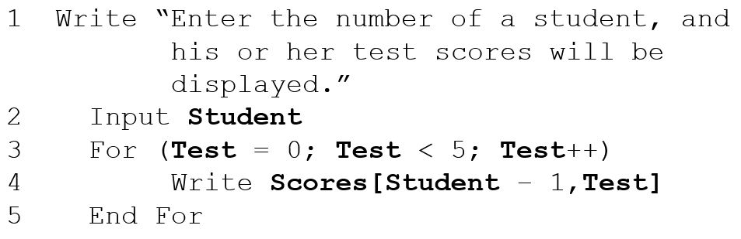
Use Nested Loops to Display the Contents of a Two-Dimensional Array

Slide 29
Example (1 of 2)
Input names and 5 test scores for a class of students into a 2-dimensional array using a sentinel-controlled loop. Display the contents of the array using the count from the input to know exactly how many student records should be displayed.

Slide 30
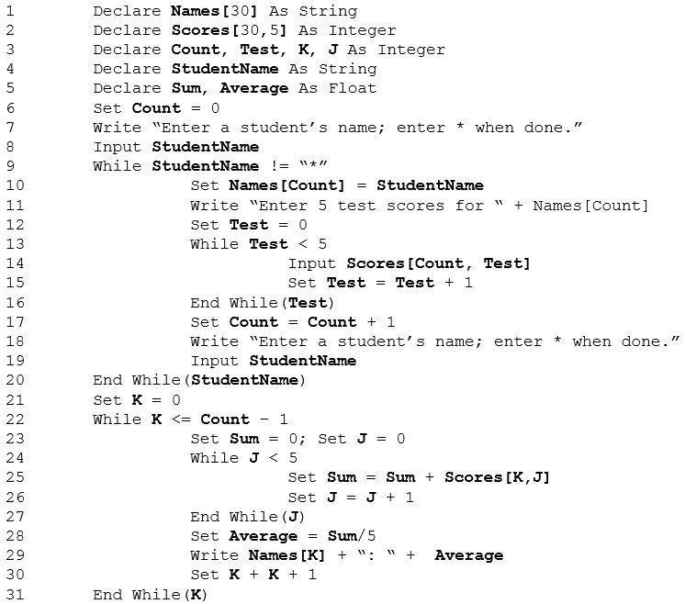
Example (2 of 2)

Slide 31

Copyright

